Slide 1
GIT PYTHON CORE

Slide 2

Agenda
Source Control Management (SCM)
Fundamental Concepts
Terms
Types of Version Control Systems
Git
Before start
Configuration
Basics
Work cycle
Branches | Merging | Rebasing
Practical tasks
HomeWork

Slide 3
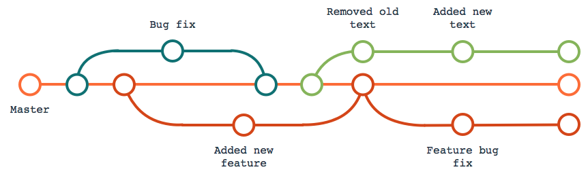
SCM
Revision control, also known as version control and source control (and an aspect of software configuration management), is the management of changes to documents, computer programs, large web sites, and other collections of information.
Notes:
A version control system serves the following purposes, among others.
Version control enables multiple people to simultaneously work on a single project. Each person edits his or her own copy of the files and chooses when to share those changes with the rest of the team. Thus, temporary or partial edits by one person do not interfere with another person's work. Version control also enables one person you to use multiple computers to work on a project, so it is valuable even if you are working by yourself.
Version control integrates work done simultaneously by different team members. In most cases, edits to different files or even the same file can be combined without losing any work. In rare cases, when two people make conflicting edits to the same line of a file, then the version control system requests human assistance in deciding what to do.
Version control gives access to historical versions of your project. This is insurance against computer crashes or data lossage. If you make a mistake, you can roll back to a previous version. You can reproduce and understand a bug report on a past version of your software. You can also undo specific edits without losing all the work that was done in the meanwhile. For any part of a file, you can determine when, why, and by whom it was ever edited.

Slide 4
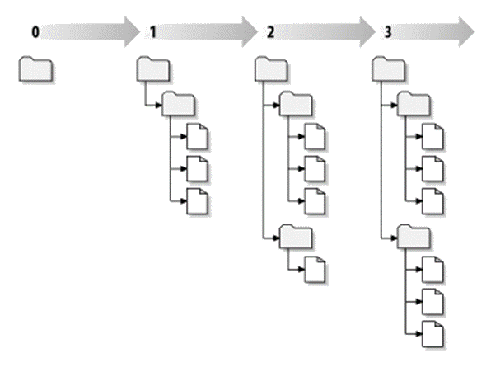
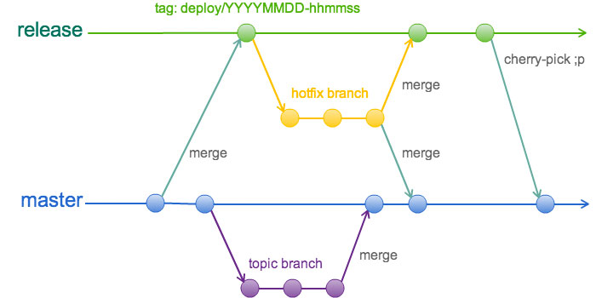
Fundamental Concepts of SCM
Tracking changes
Committing
Revisions and Change sets
Getting updates
Conflicts
Diffing (or, viewing the differences)
Branching and merging

Slide 5
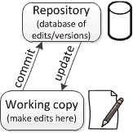
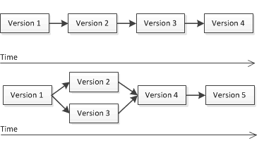
Main terms
Repository
Working Copy
Merging
Revision
Notes:
Version control uses a repository (a database of changes) and a working copy where you do your work.
Your working copy (sometimes called a checkout) is your personal copy of all the files in the project. You make arbitrary edits to this copy, without affecting your teammates. When you are happy with your edits, you commit your changes to a repository.
A repository is a database of all the edits to, and/or historical versions (snapshots) of, your project. It is possible for the repository to contain edits that have not yet been applied to your working copy. You can update your working copy to incorporate any new edits or versions that have been added to the repository since the last time you updated. See the diagram at the right.
In the simplest case, the database contains a linear history: each change is made after the previous one. Another possibility is that different users made edits simultaneously (this is sometimes called “branching”). In that case, the version history splits and then merges again.

Slide 6
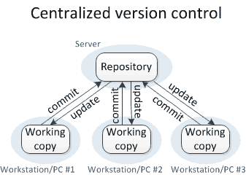
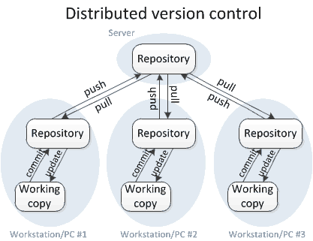
System version control
Centralized: CVS, Perforce, SVN, Team Foundation Server (TFS)
Distributed: Git, Mercurial
Notes:
Centralized VCS – These systems, such as CVS, Subversion, and Perforce, have a single server that contains all the versioned files, and a number of clients that check out files from that central place. For many years, this has been the standard for version control. In centralized version control, each user gets his or her own working copy, but there is just one central repository. As soon as you commit, it is possible for your co-workers to update and to see your changes. For others to see your changes, 2 things must happen:
You commit
They update
Distributed VCS –
In distributed version control, each user gets his or her own repository and working copy. After you commit, others have no access to your changes until you push your changes to the central repository. When you update, you do not get others' changes unless you have first pulled those changes into your repository. For others to see your changes, 4 things must happen:
You commit
You push
They pull
They update
Notice!!! that the commit and update commands only move changes between the working copy and the local repository, without affecting any other repository. By contrast, the push and pull commands move changes between the local repository and the central repository, without affecting your working copy.

Slide 7
GIT Intro
Git – is a distributed revision control system with an emphasis on speed, data integrity, and support for distributed, non-linear workflows.
Git was initially designed and developed by Linus Torvalds for Linux kernel development in 2005, and has since become the most widely adopted version control system for software development.
Every Git working directory is a full-fledged repository with complete history and full revision tracking capabilities, not dependent on network access or a central server.

Slide 8


Before start
Firstly we need to check if we have a git client software.
Download and install git
Linux OS
Debian Family (Debian, Ubuntu, Mint) #apt-get install git
Red Hat Family (RHEL, CentOS, Fedora) #yum install git
MS Windows OS https://git-scm.com/download/win
Notes:
How to check if get is present?
In Linux OS:
Run terminal
Type git --version
If the result is something like that: git version 1.7.10.4 (the number of version should be another)
In MS Windows OS
Find Git Bash program in Program Menu
Run it and type in terminal git --version

Slide 9

If we need to know sth ☺
Help yourself
$git help <command>
$git <command> --help
$man git-<command>

Slide 10
Let’s configure git ☺
Git comes with tool called git config
Identity
$ git config --global user.name “Liubov Koliasa“
$ git config --global user.email lkoliasa@mail.com
Editor
$ git config --global core.editor notepad.exe
Check settings
$ git config --list
Notes:
Git comes with a tool called git config that lets you get and set configuration variables that control all aspects of how Git looks and operates. These variables can be stored in three different places:
/etc/gitconfig file: Contains values for every user on the system and all their repositories. If you pass the option --system to git config, it reads and writes from this file specifically.
~/.gitconfig or ~/.config/git/config file: Specific to your user. You can make Git read and write to this file specifically by passing the --global option.
config file in the Git directory (that is, .git/config) of whatever repository you’re currently using: Specific to that single repository.
Each level overrides values in the previous level, so values in .git/config trump those in /etc/gitconfig.
Again, you need to do this only once if you pass the --global option, because then Git will always use that information for anything you do on that system. If you want to override this with a different name or e-mail address for specific projects, you can run the command without the --global option when you’re in that project.
Default text editor that will be used when Git needs you to type in a message. If not configured, Git uses your system’s default editor, which is generally Vim.

Slide 11
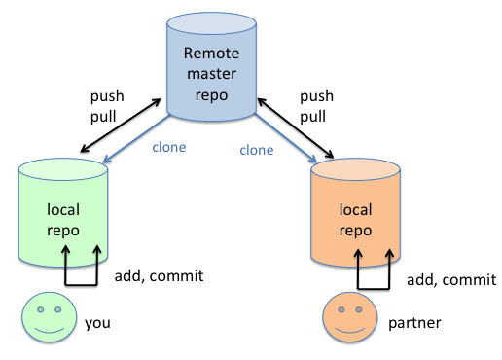
Create repository
git init – create an empty local repo
git clone <URL> – create local repo from remote repo

Slide 12
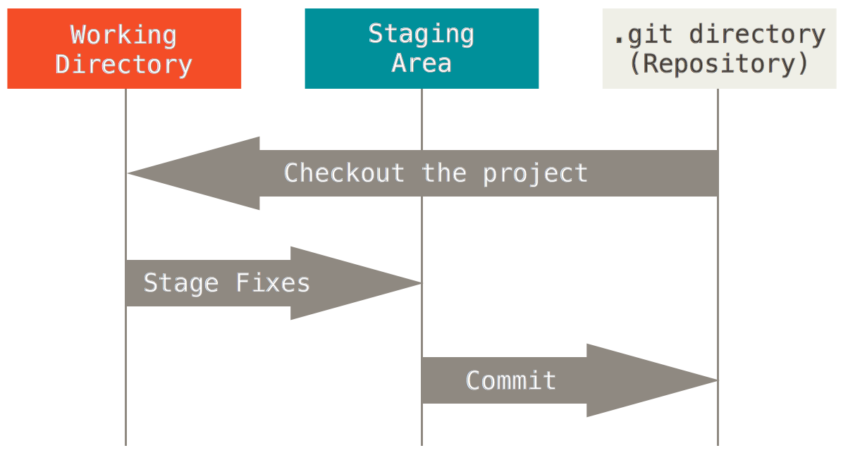
GIT basics
Git store snapshots of file system not differences!!!
Almost every operation is local
Notes:
Git has three main states that your files can reside in: committed, modified, and staged.
Committed means that the data is safely stored in your local database.
Modified means that you have changed the file but have not committed it to your database yet.
Staged means that you have marked a modified file in its current version to go into your next commit snapshot.
The Git directory is where Git stores the metadata and object database for your project. This is the most important part of Git, and it is what is copied when you clone a repository from another computer.
The working directory is a single checkout of one version of the project. These files are pulled out of the compressed database in the Git directory and placed on disk for you to use or modify.
The staging area is a file, generally contained in your Git directory, that stores information about what will go into your next commit. It’s sometimes referred to as the “index”, but it’s also common to refer to it as the staging area.
The basic Git workflow goes something like this:
You modify files in your working directory.
You stage the files, adding snapshots of them to your staging area.
You do a commit, which takes the files as they are in the staging area and stores that snapshot permanently to your Git directory.

Slide 13
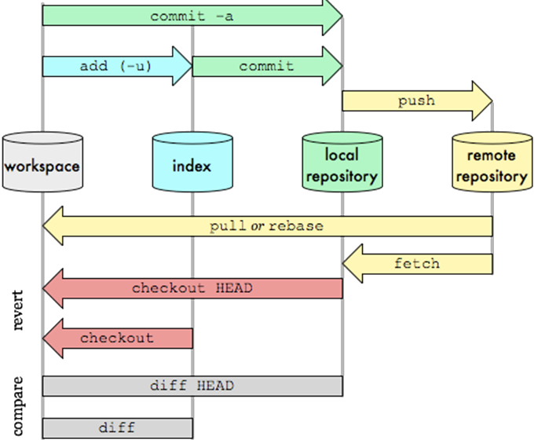
Git data transport commands

Slide 14

Must know commands!
git status - Show the working tree status
git log – Show commit logs
git rm – Remove files from the working tree and from the index

Slide 15
GIT Work Cycle
clone repository
modify branch
update branch and review changes
commit changes
push changes to repo
create your branch
Clone repository
git clone
git init
Create your branch
git branch
Modify working copy
git add
git reset
git mv
git rm
Update branch and review changes
git status
git log
git diff
git fetch
Commit changes
git commit
Push changes to repo
git push

Slide 16

Branch
A branch represents an independent line of development. Branches serve as an abstraction for the edit/stage/ commit process
Commands
git branch – list of branches in local repo
git branch <name> – create new local branch named “name”
git branch –d <name> – delete the branch named “name”
git branch –m <name> – rename the current branch to “name”

Slide 17
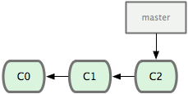
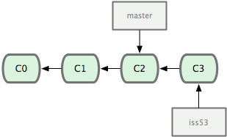
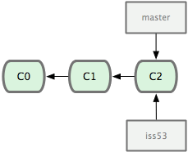
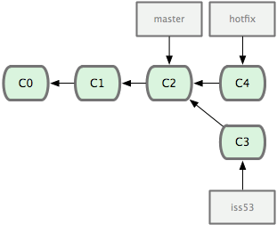
Let’s imagine
1
Three commits on master
3
git commit …
2
4
git checkout master
git checkout –b hotfix
git commit …
git checkout –b iss53

Slide 18
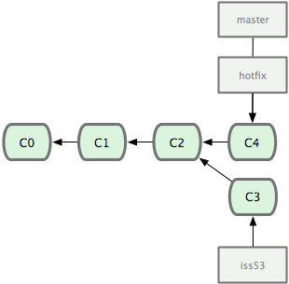
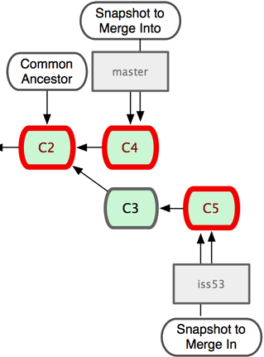
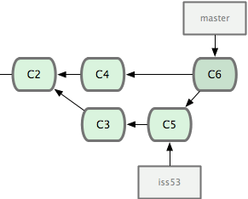
Merging
5
6
git checkout master
git merge hotfix
7
git merge iss53
Notes:
git log --graph --oneline --all

Slide 19
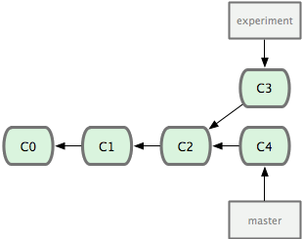
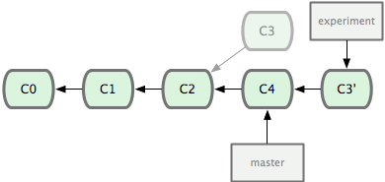
Rebasing
1
Some initial state
git checkout experiment
git rebase master
2

Slide 20
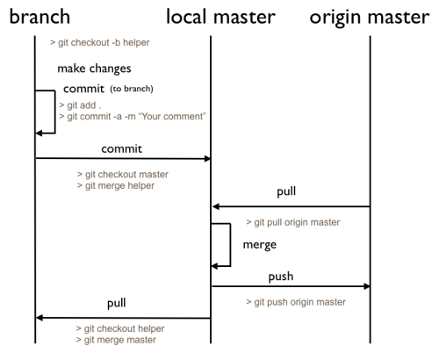
Team player / issue / bug fix philosophy

Slide 21
Command syntax | Description
repo init | initializes a new client
repo sync | syncs client to repositories
repo start | starts a new branch
git add | stages files ( adds to index )
repo status | shows status of current branch
git commit | commits staged files
git branch | shows current branches
git branch [branch] | creates new topic branch
git checkout [branch] | switches HEAD to specified branch
git merge [branch] | merges [branch] with current branch
git diff | shows diff of unstaged changes
git log | shows history on current branch
repo upload | Uploads changes to review server

Slide 22
Tasks
Clone repository https://github.com/kolyasalubov/Lv-367.PythonCore.git
Add to file «ZenPython.txt» few lines and commit it to local repository.
Push it to remote repository.
Make branch and checkout to it
Add few lines in the file.
Push changes to remote repo.
Merge the branch with master
Resolve conflicts, if needed
View master log.
Notes:
The Zen of Python, by Tim Peters
1.Beautiful is better than ugly.
2.Explicit is better than implicit.
3.Simple is better than complex.
4.Complex is better than complicated.
5.Flat is better than nested.
6.Sparse is better than dense.
7.Readability counts.
8.Special cases aren't special enough to break the rules.
9.Although practicality beats purity.
10.Errors should never pass silently.
11.Unless explicitly silenced.
12.In the face of ambiguity, refuse the temptation to guess.
13.There should be one-- and preferably only one --obvious way to do it.
14.Although that way may not be obvious at first unless you're Dutch.
15.Now is better than never.
16.Although never is often better than *right* now.
17.If the implementation is hard to explain, it's a bad idea.
18.If the implementation is easy to explain, it may be a good idea.
19.Namespaces are one honking great idea -- let's do more of those!
1. Як умру, то поховайте
2. Мене на могилі
3. Серед степу широкого
4. На Вкраїні милій,
5. Щоб лани широкополі,
6. І Дніпро, і кручі
7. Було видно, було чути,
8. Як реве ревучий.
9. Як понесе з України
10. У синєє море
11. Кров ворожу... отойді я
12. І лани і гори —
13. Все покину, і полину
14. До самого Бога
15. Молитися... а до того
16. Я не знаю Бога.
17. Поховайте та вставайте,
18. Кайдани порвіте
19. І вражою злою кров’ю
20. Волю окропіте.
21. І мене в сем’ї великій,
22. В сем’ї вольній, новій,
23. Не забудьте пом’янути
24. Незлим тихим словом.

Slide 23
HomeWork (online course)
Play on site https://try.github.io
Please register on Learn Git Branching: http://learngitbranching.js.org/
and play game
Clone repo
https://github.com/kolyasalubov/Lv-367.PythonCore.git
Create branch <your name>
Push into this branch your project from HW 1

Slide 24
References and Sources
Simplified views:
Everyday commands
Visual guide to GIT
Easy version control with GIT
Some videos
What is GIT
Overview of Branching, Cloning, Pulling, and Merging. Demo of it on Git Bash
Merge Conflicts. Git Tagging
GIT for small teams
Workflow for small teams
Advanced philosophy:
Advanced programmer guide to GIT
Version control SVN and GIT

Slide 25
THANK YOU FOR ATTENTION

